Slide 1
Scrum with Team Foundation Server 2010
Aaron Bjork
Senior Program Manager
Microsoft Corporation

Slide 2

Agenda
Scrum with TFS 2010 using MSF for Agile 5.0
Planning the Project
How do you plan the project?
Project planning in TFS 2010
Planning a Sprint
What is sprint planning?
Sprint planning in TFS 2010
Running a Sprint
How do you run a sprint?
Running a sprint in TFS 2010

Slide 3
How do you Plan the Project?
Product Backlog
Evolving backlog of user stories (requirements)
Describes what users need and value
Owned by the Product Owner
Prioritized by business value
Each story is written from the user’s perspective

Slide 4
Planning the Project
Product Backlog
“As a new customer I want to register online so I can use the services offered”
User Stories
5
8
Stories are listed on the backlog in priority order
5
The team estimates each story using story points
Priority
3
New stories are added to the product backlog
8
1

Slide 5
Planning the Project
Product Backlog
Stories are planned for completion in upcoming sprints
User Stories
Sprint 3
3
3
3
Sprint 4
The product owner re-prioritizes the backlog
Priority
4
4
4

Slide 6
… let’s look at the Product Backlog in TFS 2010

Slide 7
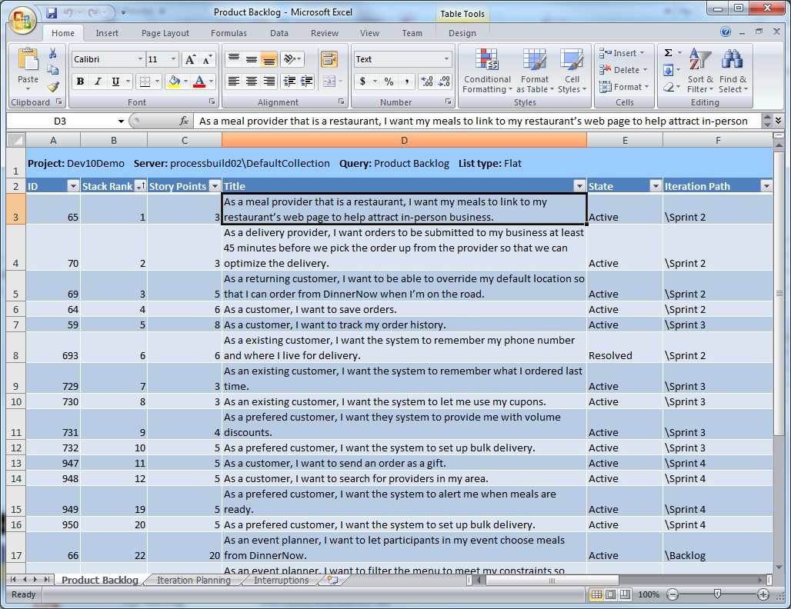
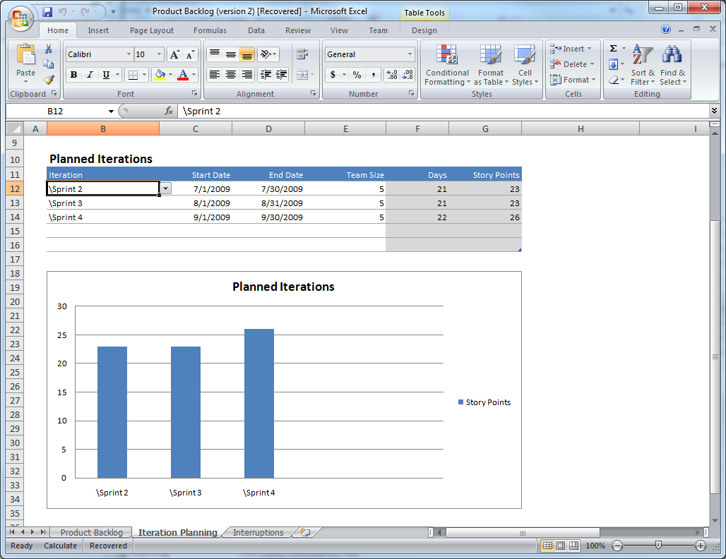
Product Backlog in TFS 2010
Product Backlog query
Creating new user stories
Prioritizing
Estimating story points
Add user stories to upcoming sprints

Slide 8
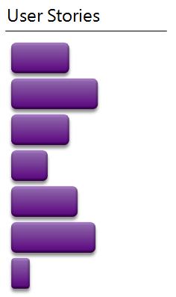
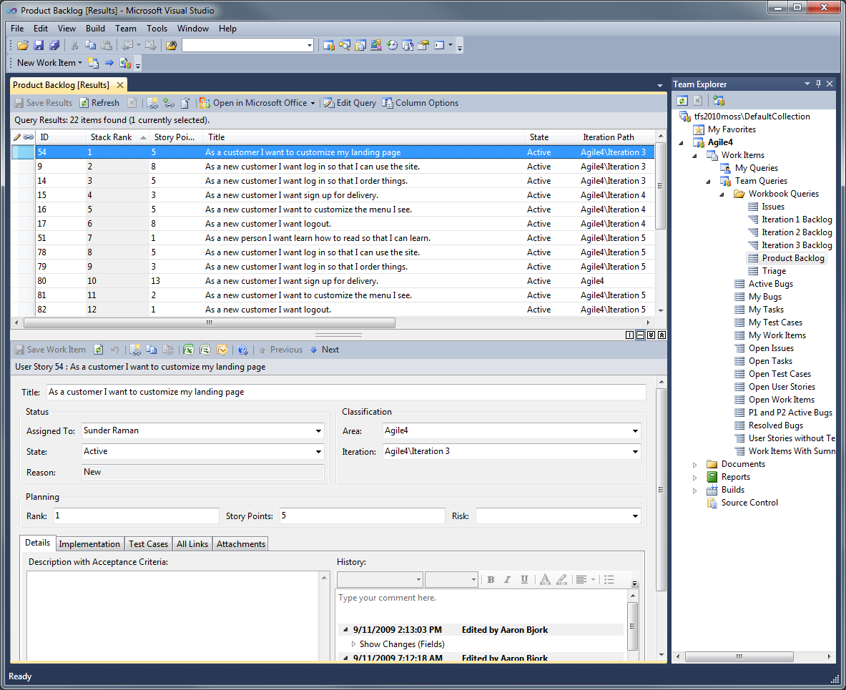
Product Backlog
Product backlog query in Team Explorer

Slide 9
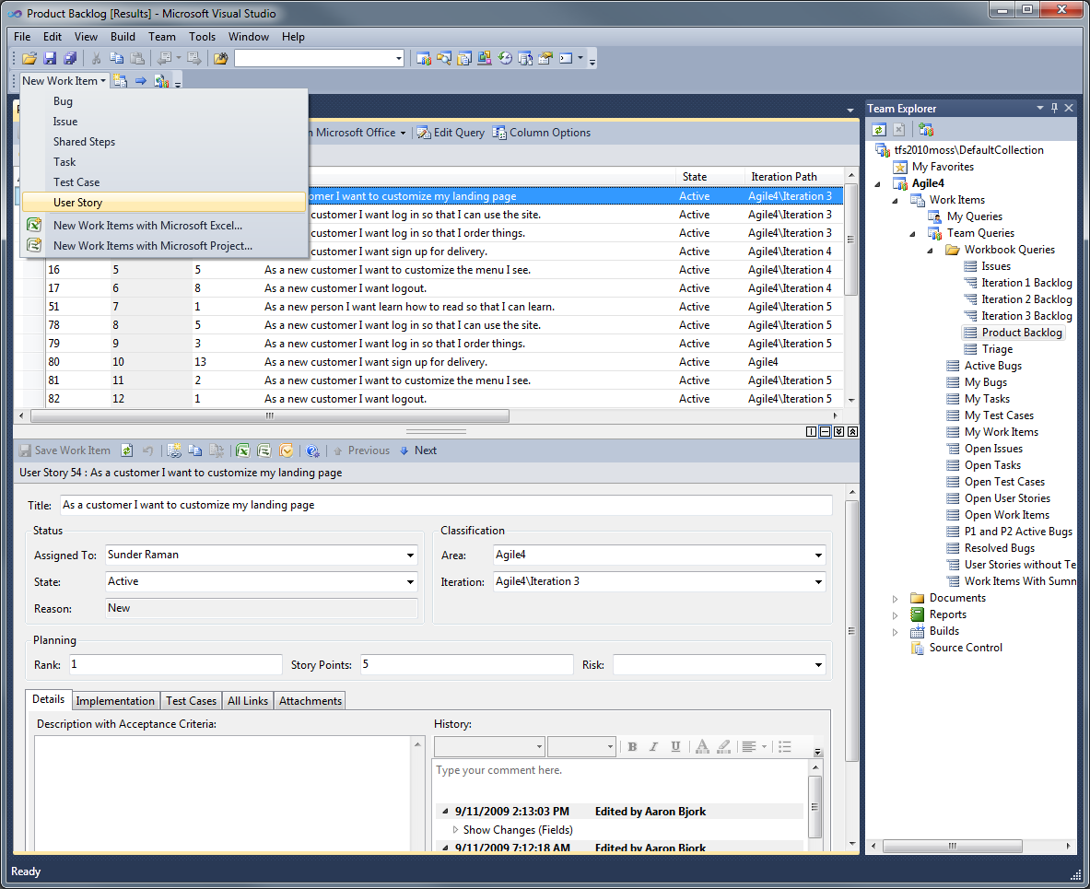
Product Backlog
New stories created by the Product Owner

Slide 10
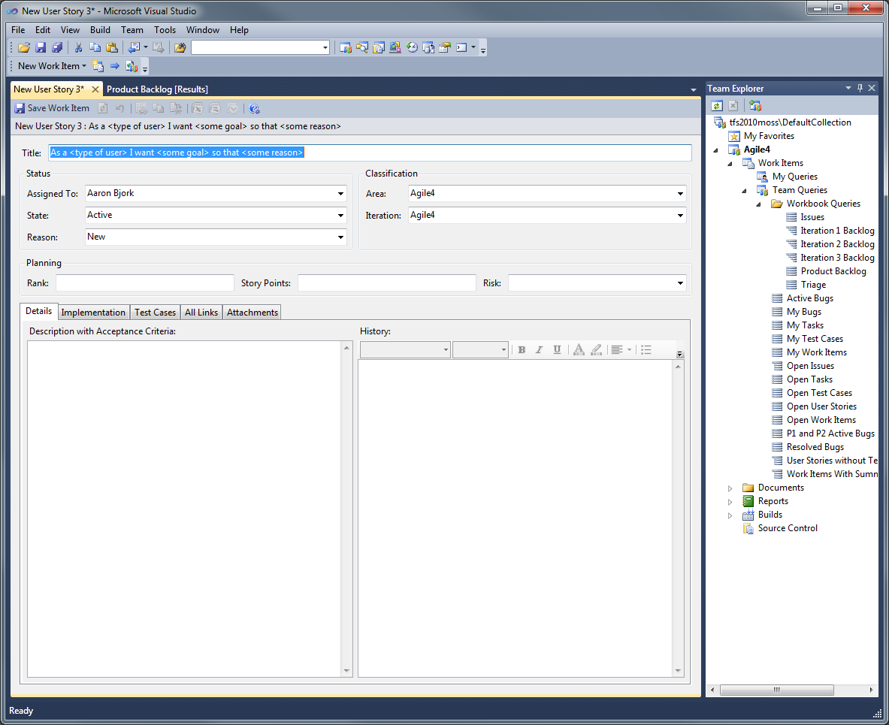
Product Backlog
The new story provides a guide to ensure the story is written from the customer’s perspective

Slide 11
Product Backlog
Each story is ranked by priority and assigned a story point value

Slide 12
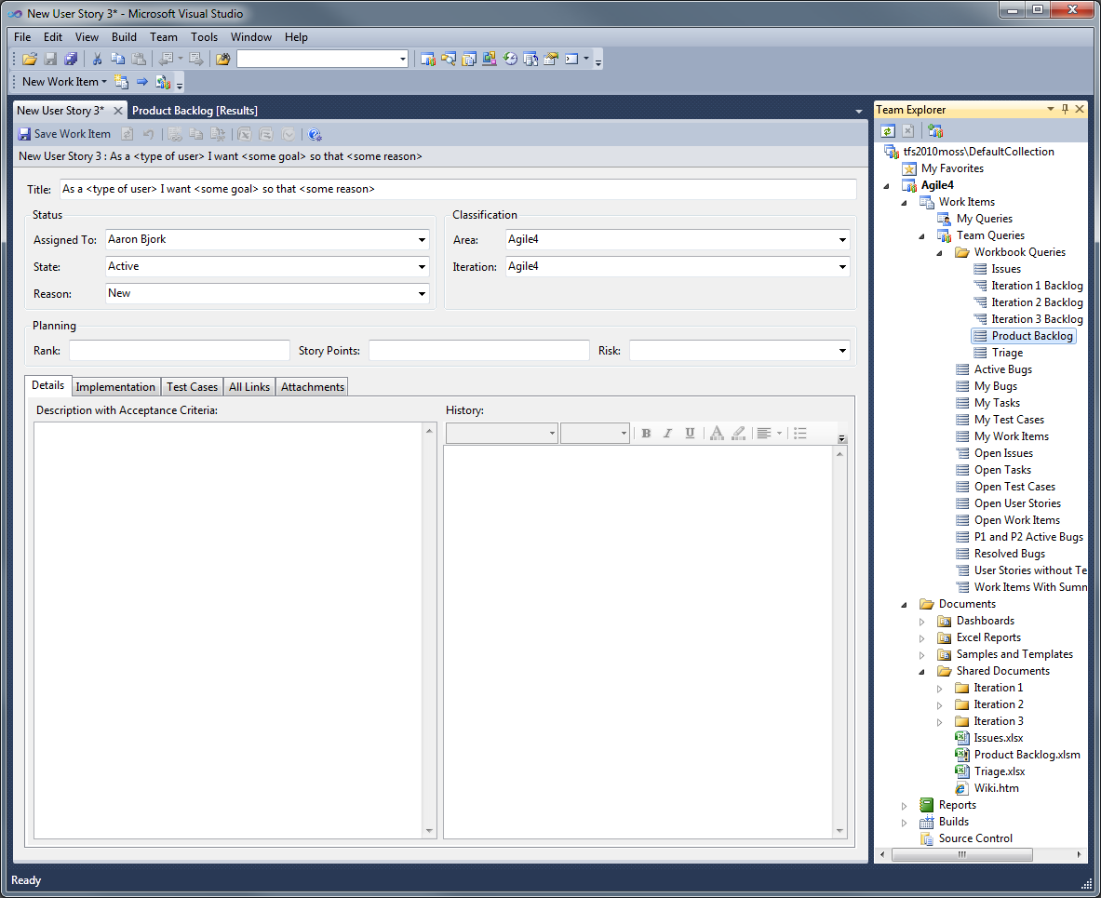
Product Backlog
Product Backlog workbook for planning future sprints

Slide 13
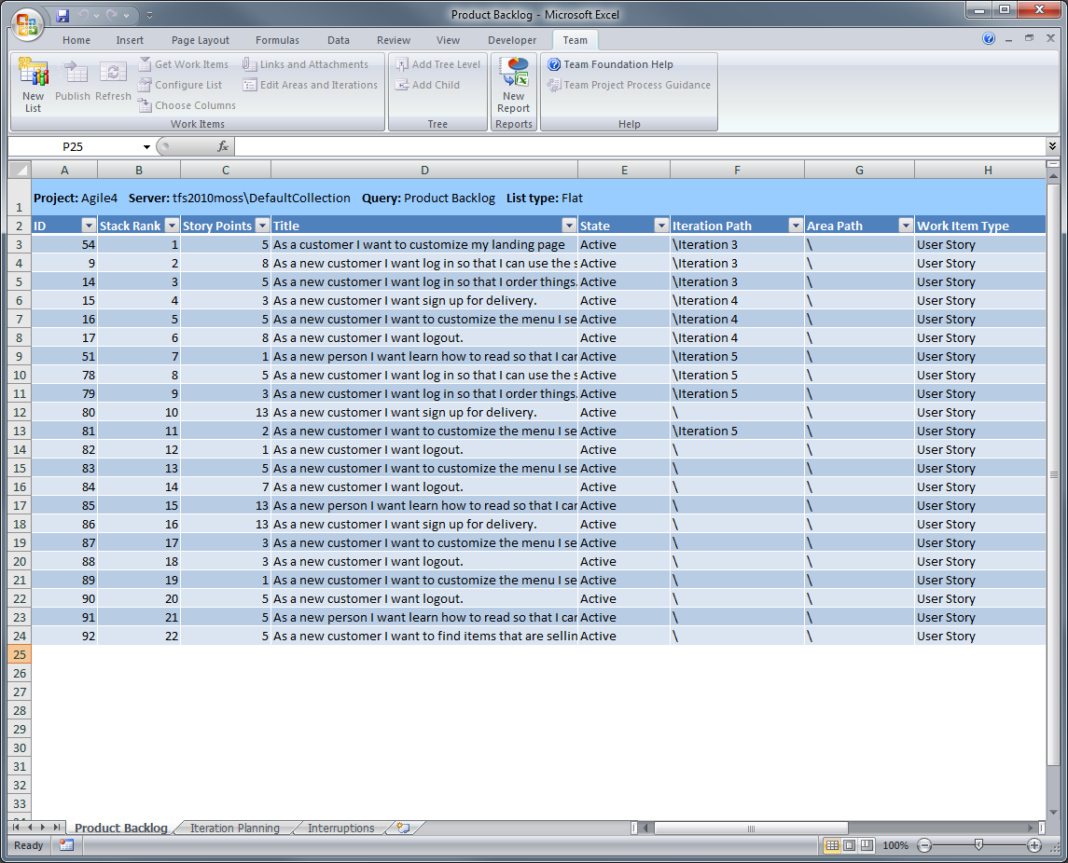
Product Backlog Workbook
Stories that are too large are left on the backlog
Each story is placed in an upcoming sprint

Slide 14
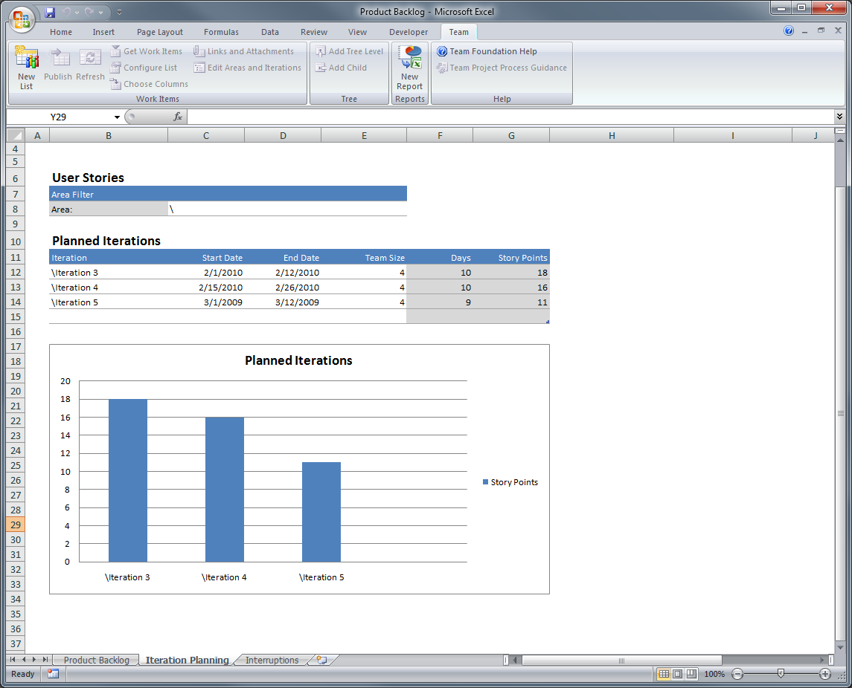
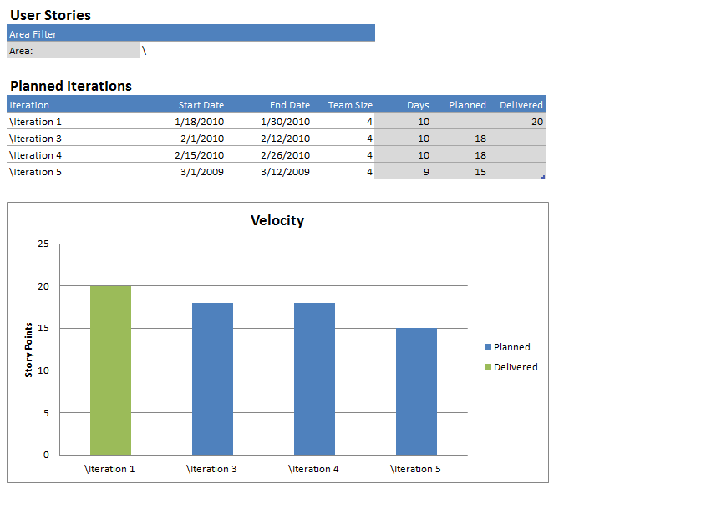
Product Backlog Workbook
The product owner can use the velocity of the team to help plan for upcoming sprints
… with start/end dates and the size of the team
Each sprint is added to Iteration Planning worksheet…

Slide 15

Agenda
Scrum with TFS 2010 using MSF for Agile 5.0
Planning the Project
How do you plan the project?
Project planning in TFS 2010
Planning a Sprint
What is sprint planning?
Sprint planning in TFS 2010
Running a Sprint
How do you run a sprint?
Running a sprint in TFS 2010

Slide 16
What is Sprint Planning?
The product owner and the team add user stories to the sprint
Each story is decomposed into tasks
The team makes a commitment to each user story

Slide 17
Planning a Sprint
Product Backlog
Iteration Backlog
User Stories
User Stories
Tasks (hours)
Based on estimates the team commits to each story
Commit!
3
3
The team thinks this story is more work than they can commit to…
During the sprint planning meeting, the product owner and the team add User Stories to the sprint
3
The team breaks down each story into tasks
Commit!
Can’t Commit!

Slide 18
Planning a Sprint
Product Backlog
Iteration Backlog
User Stories
User Stories
User Stories
Tasks (hours)
Tasks (hours)
Commit!
3
3
3
The larger story is removed from the sprint and the team considers a smaller story on the backlog
Commit!
?
3
The sprint is now planned and the team is ready to get started!
The team can commit to this smaller story
Commit!
Notes:
Add animation and a “can’t commit”…
Move a smaller up…

Slide 19
… let’s look at Sprint Planning in TFS 2010

Slide 20
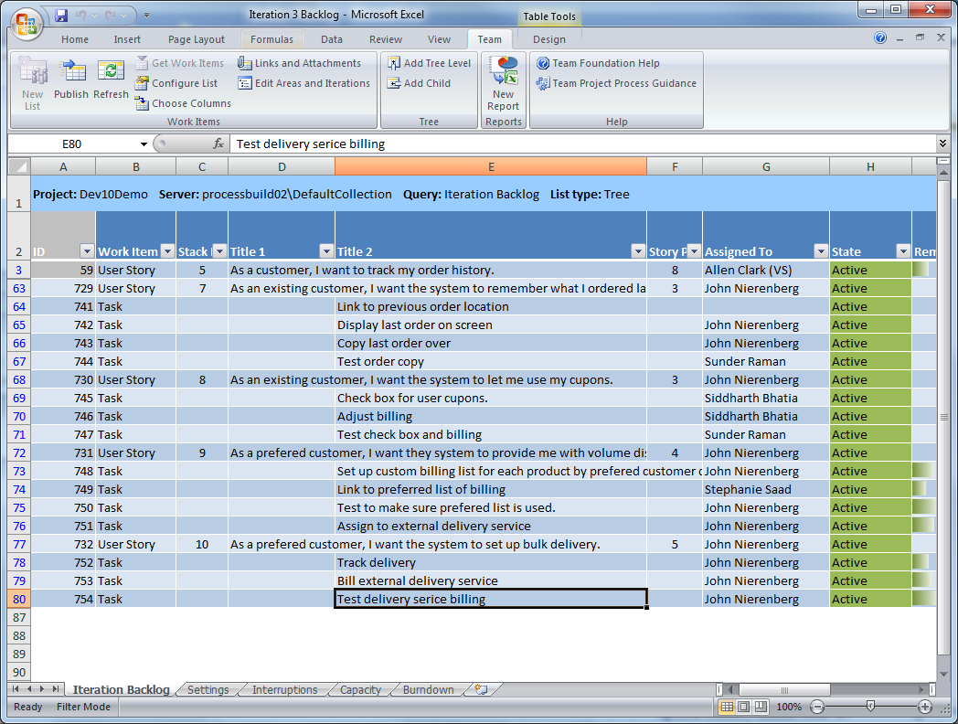
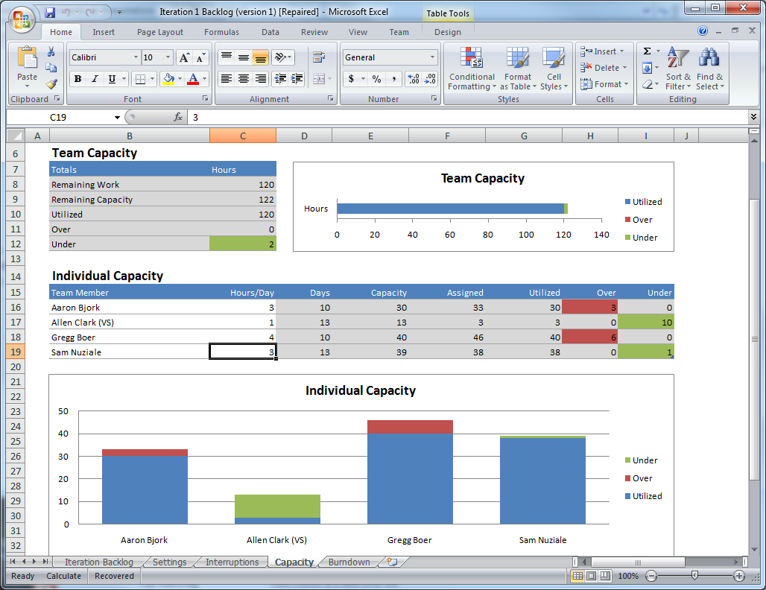
Sprint Planning
Break down user stories into tasks
Load balance
Commit
Track interruptions
Track progress

Slide 21
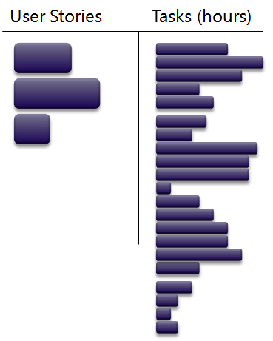
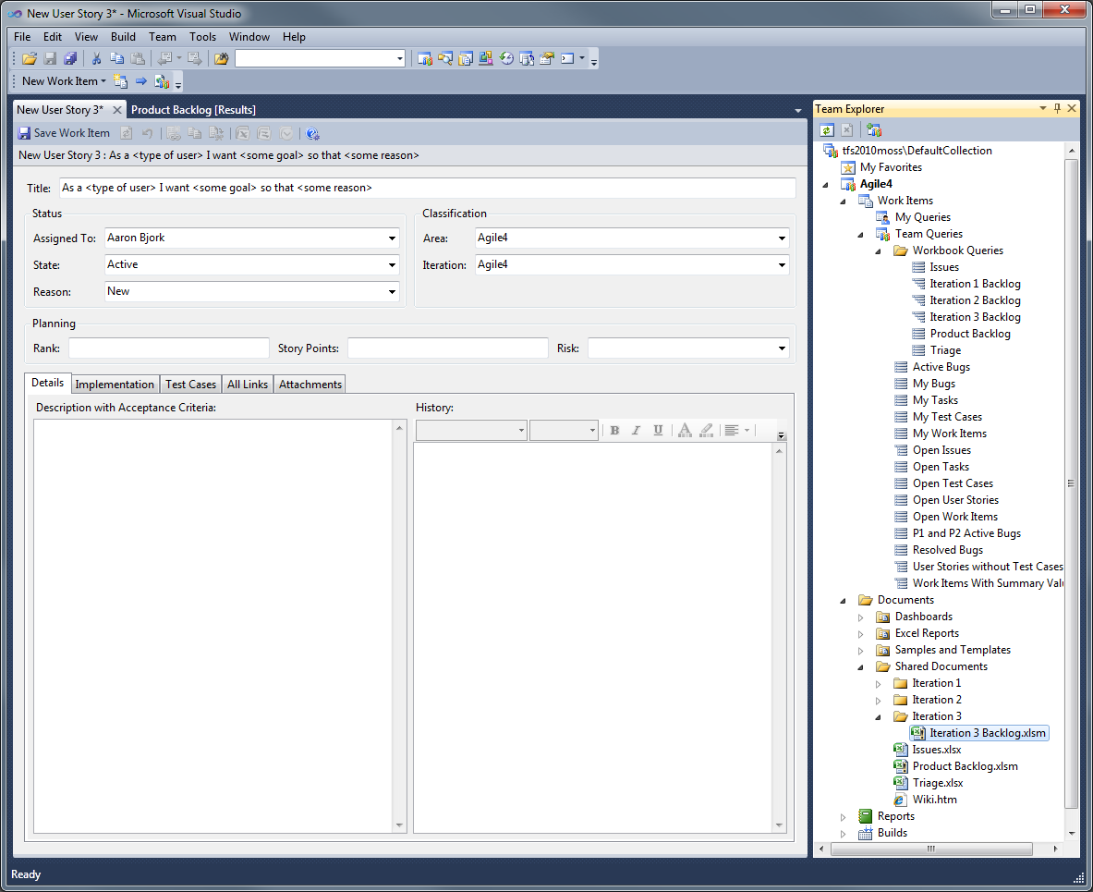
Iteration Backlog Workbook
Each sprint has an Excel workbook to assist the team in making a commitment

Slide 22
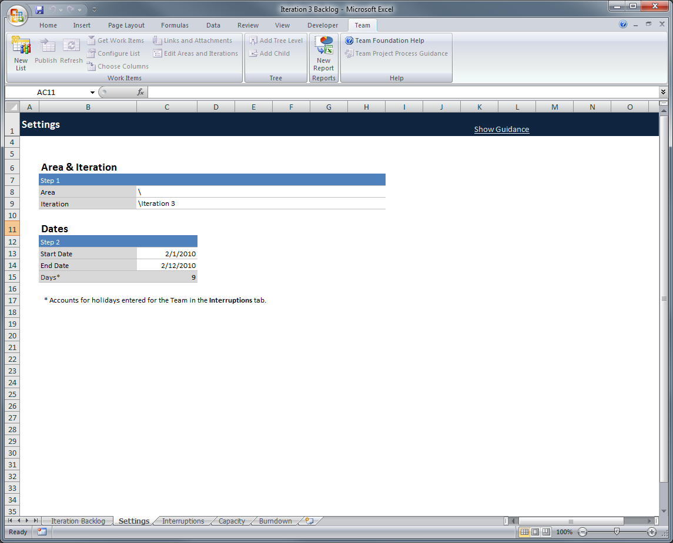
Iteration Backlog Workbook
Dates for the sprint are added…

Slide 23
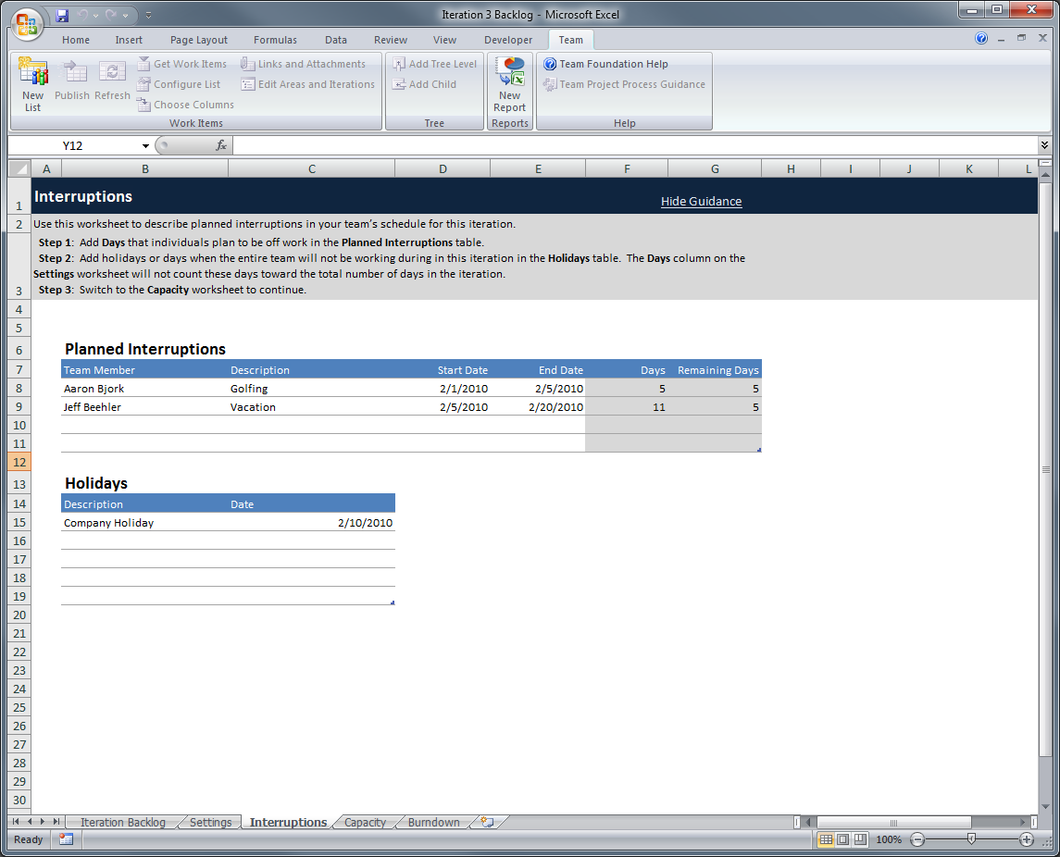
Iteration Backlog Workbook
... and any planned interruptions

Slide 24
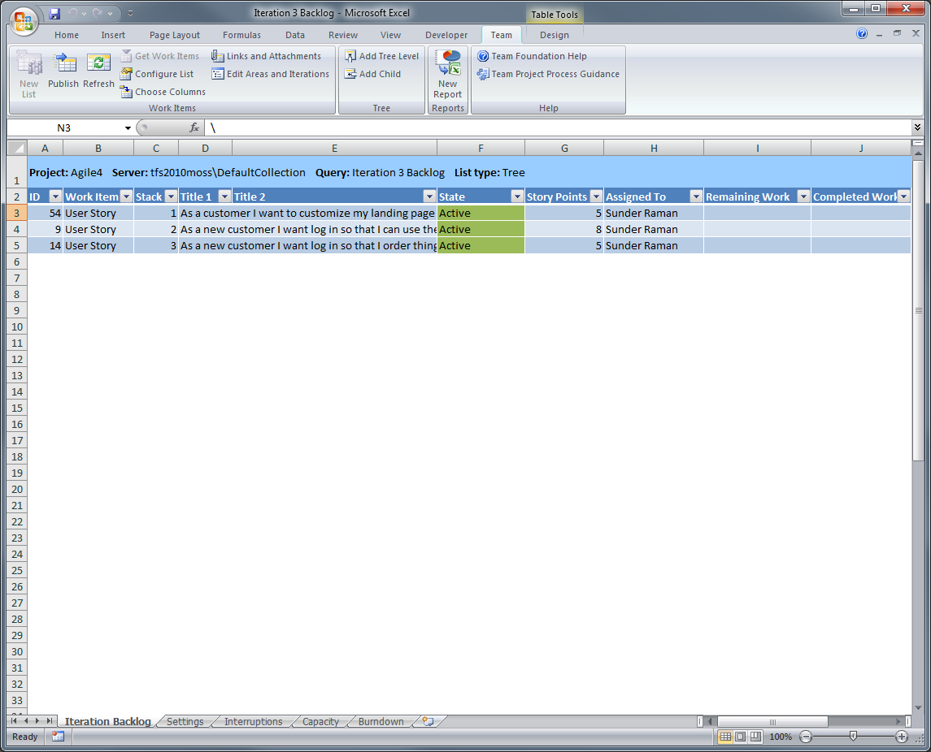
Iteration Backlog Workbook
The team breaks down the first user story into tasks

Slide 25
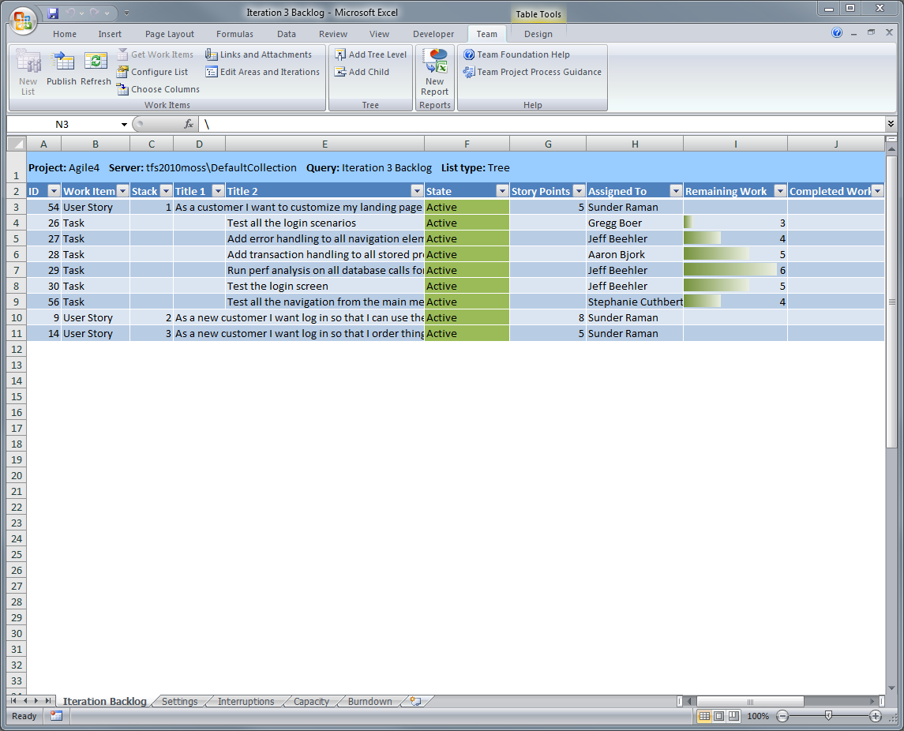
Iteration Backlog Workbook
Each task is estimated in hours

Slide 26
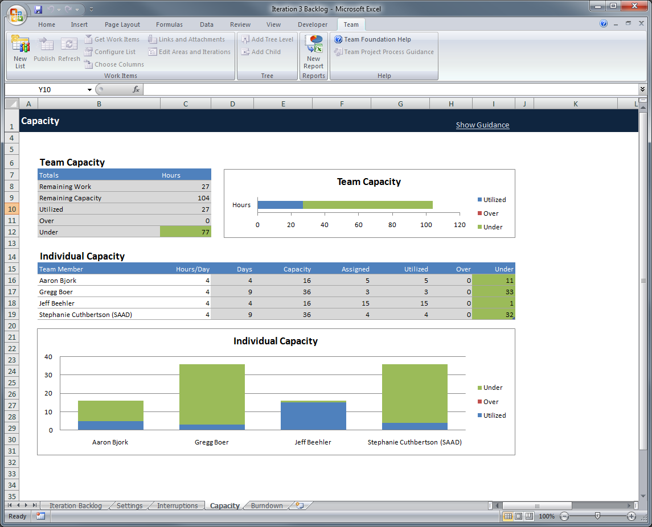
Iteration Backlog Workbook
The team checks their capacity for the sprint

Slide 27
Iteration Backlog Workbook
The next story is broken down…

Slide 28
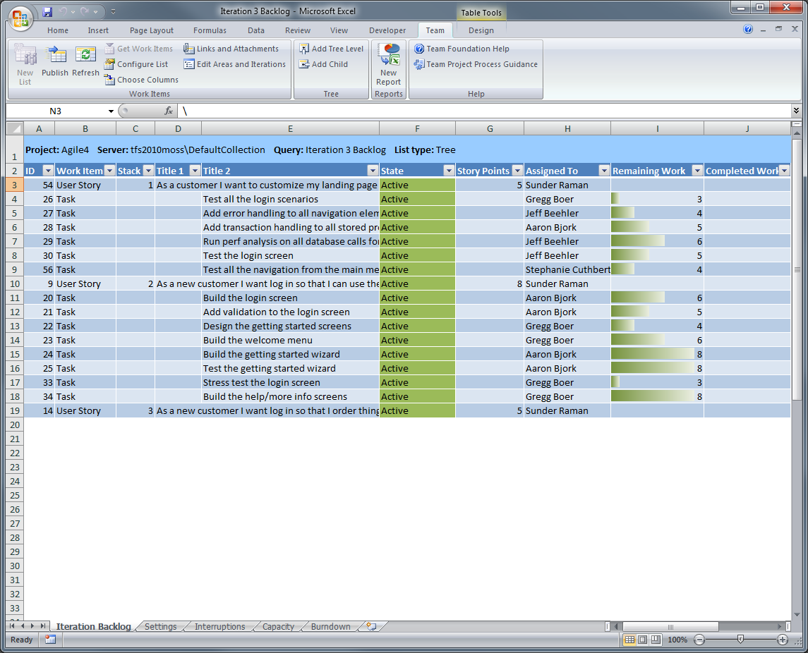
Iteration Backlog Workbook

Slide 29
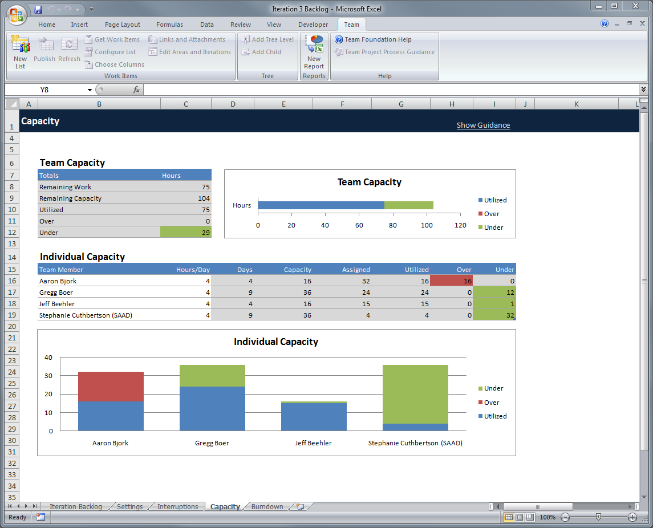
Iteration Backlog Workbook
The team has capacity…
… but one team member has too much work

Slide 30
Iteration Backlog Workbook

Slide 31
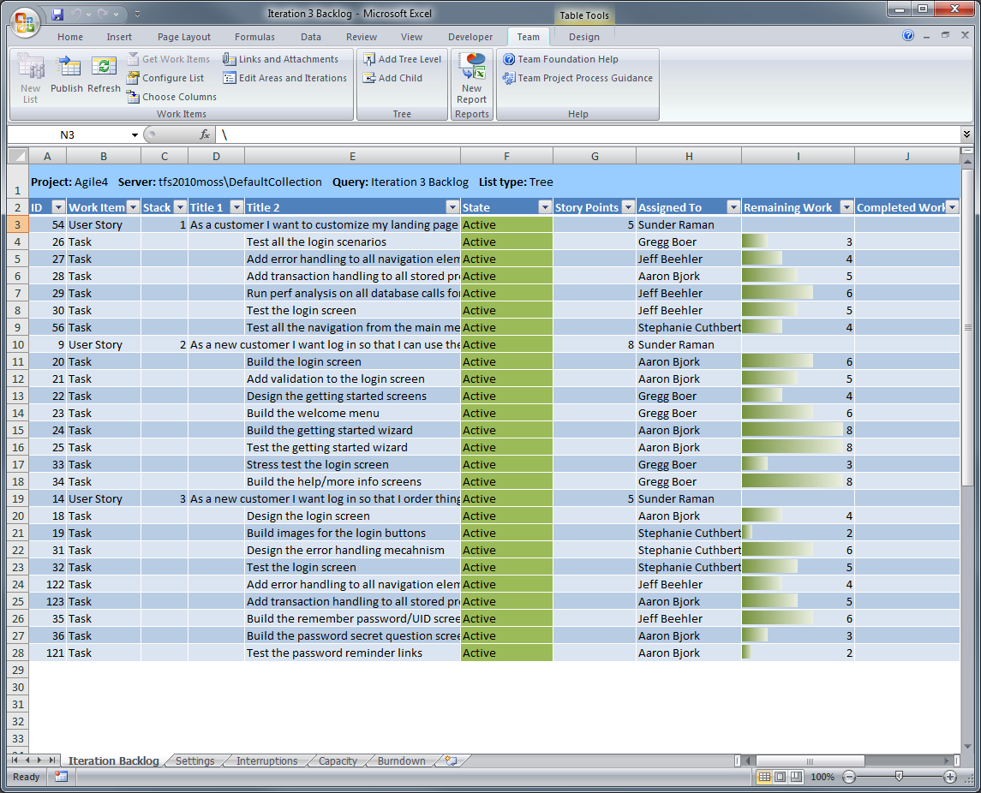
Iteration Backlog Workbook
The final story is broken down

Slide 32
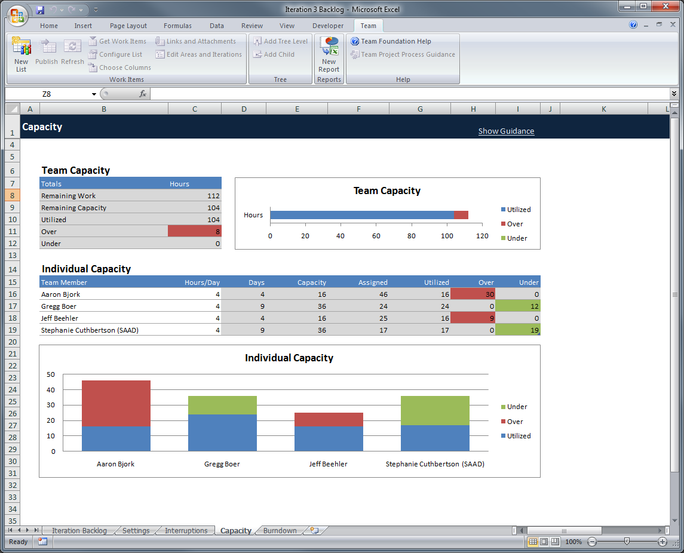
Iteration Backlog Workbook
Based on capacity and estimates, the team is overcommitted

Slide 33
Iteration Backlog Workbook
The final story is removed…

Slide 34
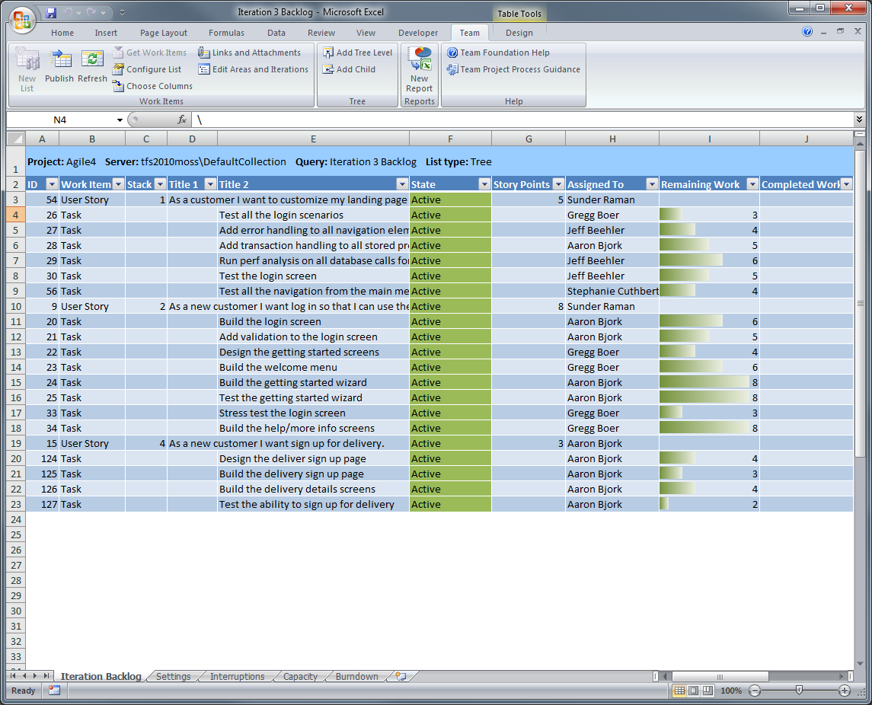
Iteration Backlog Workbook
And replaced with a smaller story from the product backlog

Slide 35
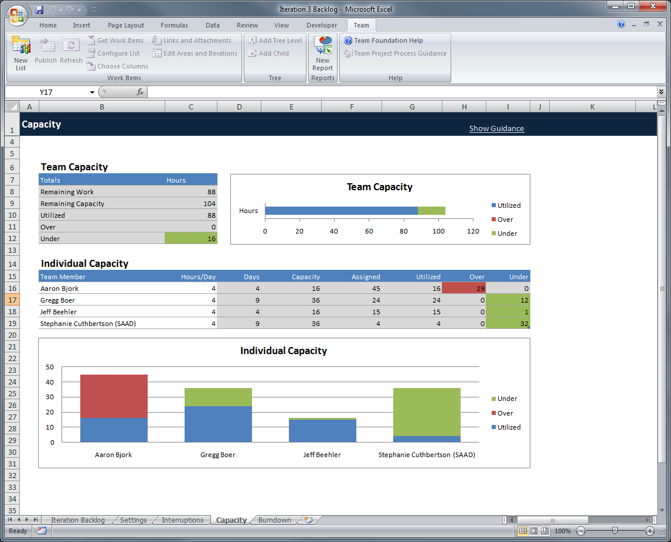
Iteration Backlog Workbook
… but one team member still has too much work
The team is comfortable committing to this story…

Slide 36
Iteration Backlog Workbook
Tasks are reassigned

Slide 37
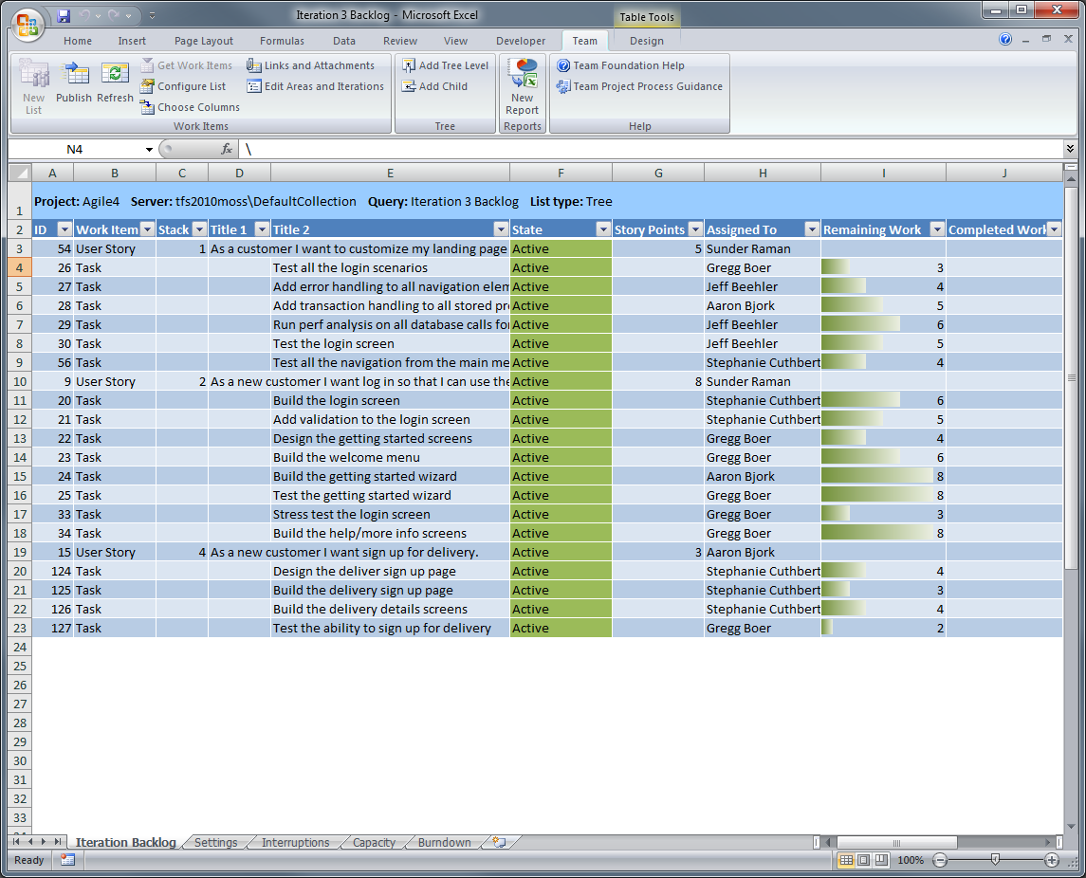
Iteration Backlog Workbook
Tasks are reassigned

Slide 38
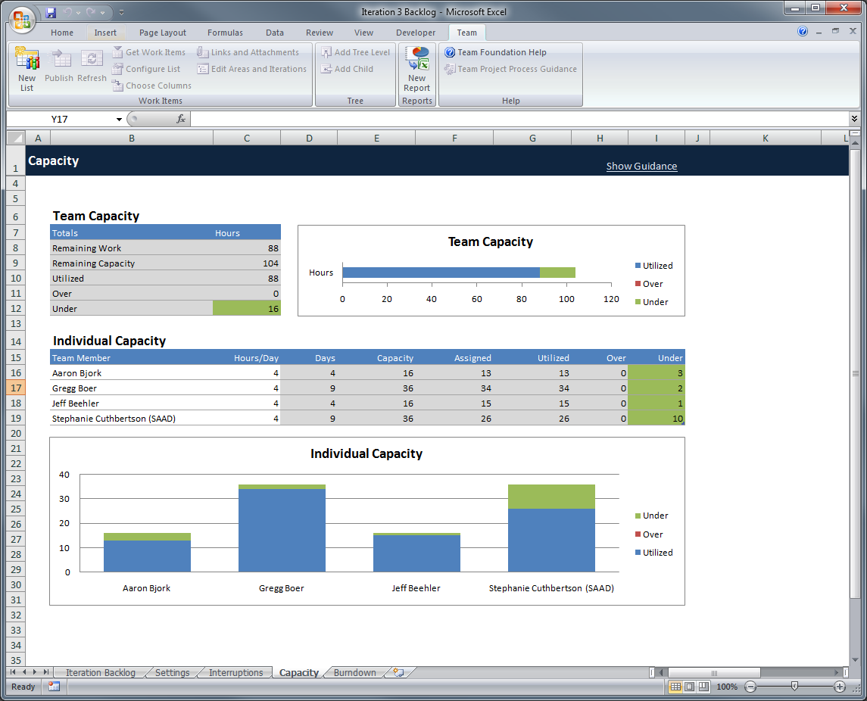
Iteration Backlog Workbook
Work is now load balanced across the team

Slide 39
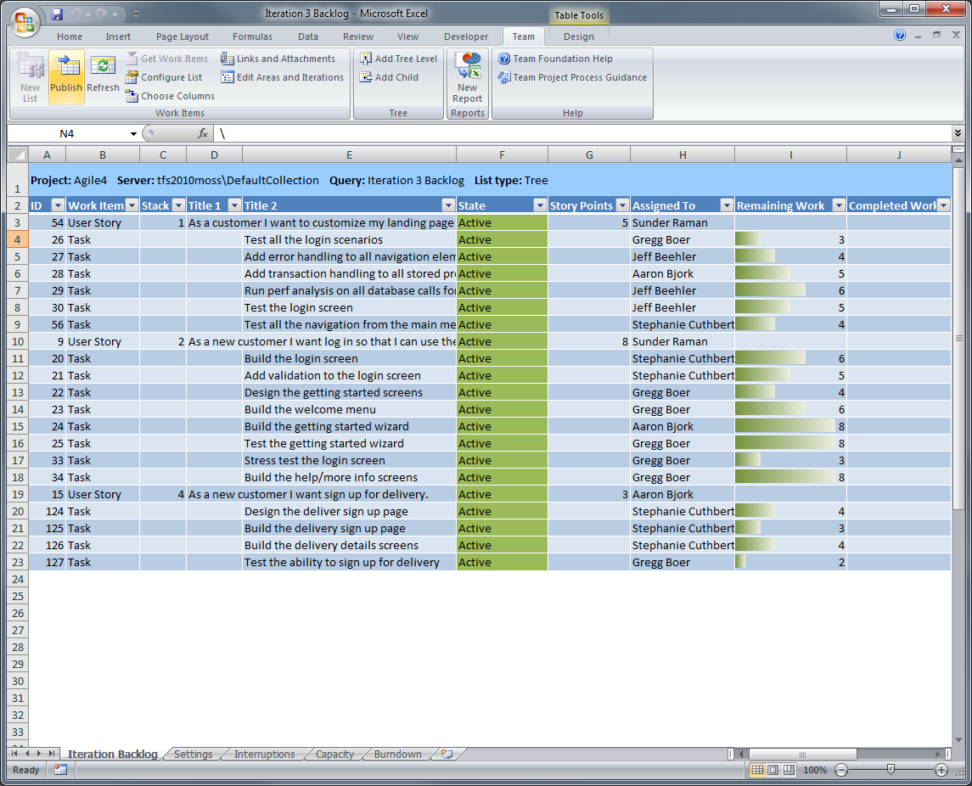
Iteration Backlog Workbook
The final step is to publish the data back to TFS
Sprint planning is complete!

Slide 40
Agenda
Scrum with TFS 2010 using MSF for Agile 5.0
Planning the Project
How do you plan the project?
Project planning in TFS 2010
Planning a Sprint
What is sprint planning?
Sprint planning in TFS 2010
Running a Sprint
How do you run a sprint?
Running a sprint in TFS 2010

Slide 41
How do you Run a Sprint?
Track Progress
Daily Sprint Meeting
What work has been completed
What work remains
Deliver a “potentially shippable” increment
Demo the value delivered
Retrospective

Slide 42
Running a Sprint
Product Backlog
Iteration Backlog
User Stories
User Stories
Tasks (hours)
The team starts work on the tasks…

Slide 43
Running a Sprint
Product Backlog
Iteration Backlog
User Stories
User Stories
Tasks (hours)
Completed work is reported daily

Slide 44
Running a Sprint
Product Backlog
Iteration Backlog
User Stories
User Stories
Tasks (hours)

Slide 45
Running a Sprint
Product Backlog
Iteration Backlog
User Stories
User Stories
Tasks (hours)
Each User Story has been implemented
All work for the sprint is “done-done”

Slide 46
Running a Sprint
Product Backlog
Iteration Backlog
User Stories
User Stories
Tasks (hours)
And the team has developed a “potentially shippable” increment
The team holds a demo to show the value they have delivered
Notes:
Add a not-finished…
Red -

Slide 47
Running a Sprint
Product Backlog
Iteration Backlog
User Stories
User Stories
Tasks (hours)
The latest increment is shipped to customers
Notes:
Add animation and a “can’t commit”…
Move a smaller up…

Slide 48
Running a Sprint
Product Backlog
Iteration Backlog
User Stories
User Stories
Tasks (hours)
Stories and tasks are cleared from the backlog – the team delivered on its commitment
Stories delivered in the last sprint are closed
What worked?
What didn’t work? What can the team do to improve?
The team holds a retrospective…

Slide 49
Running a Sprint
Product Backlog
Iteration Backlog
User Stories
User Stories
Tasks (hours)
New Stories are added to the Product Backlog

Slide 50
Running a Sprint
Product Backlog
Iteration Backlog
User Stories
User Stories
Tasks (hours)
The backlog is prioritized and ready for the team to plan the next sprint

Slide 51
… let’s look at Running a Sprint in TFS 2010

Slide 52
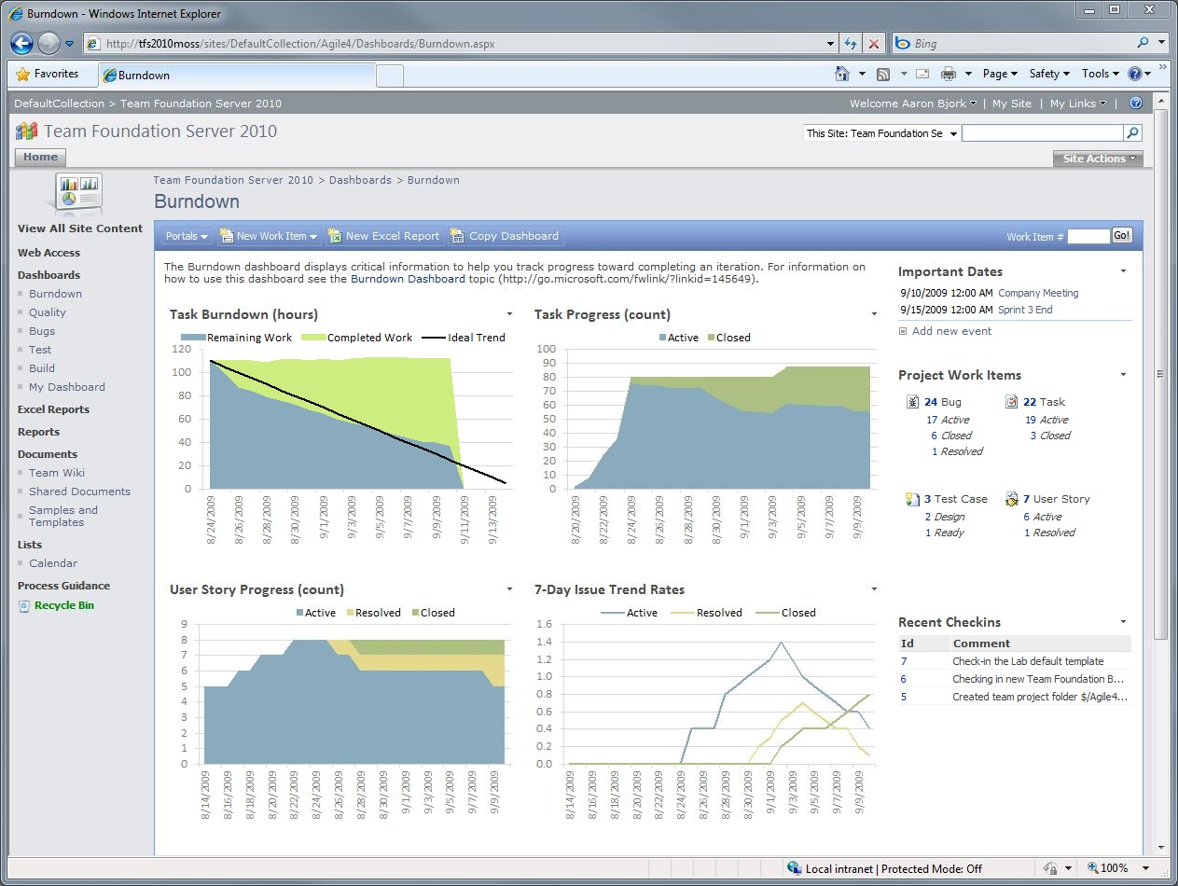
Running a Sprint
Record completed work daily
Track progress with reports and dashboards
Retrospectives

Slide 53
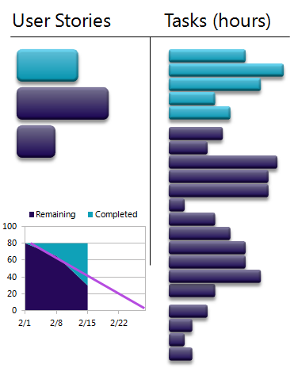
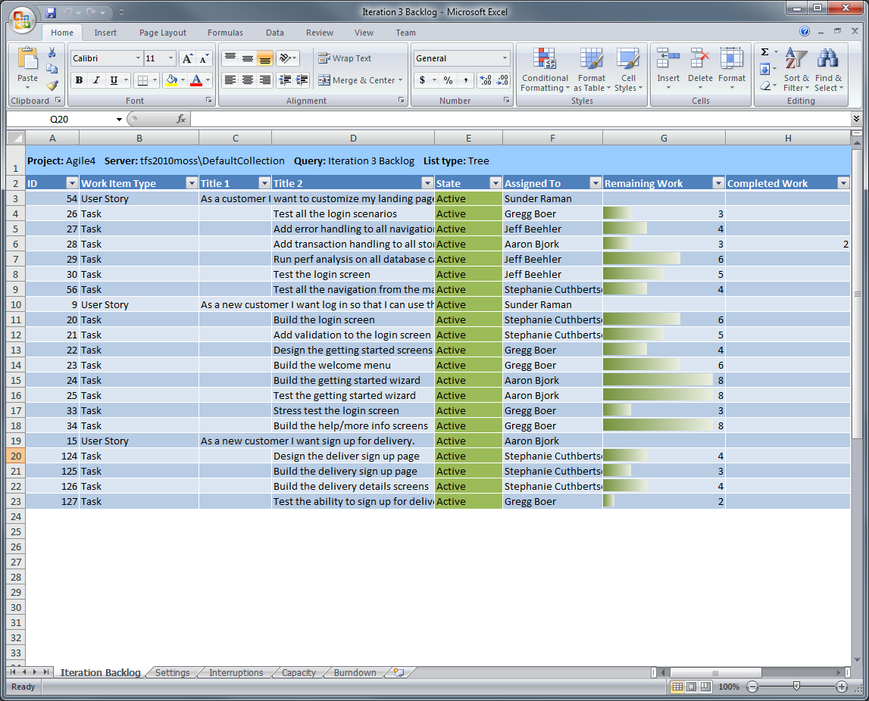
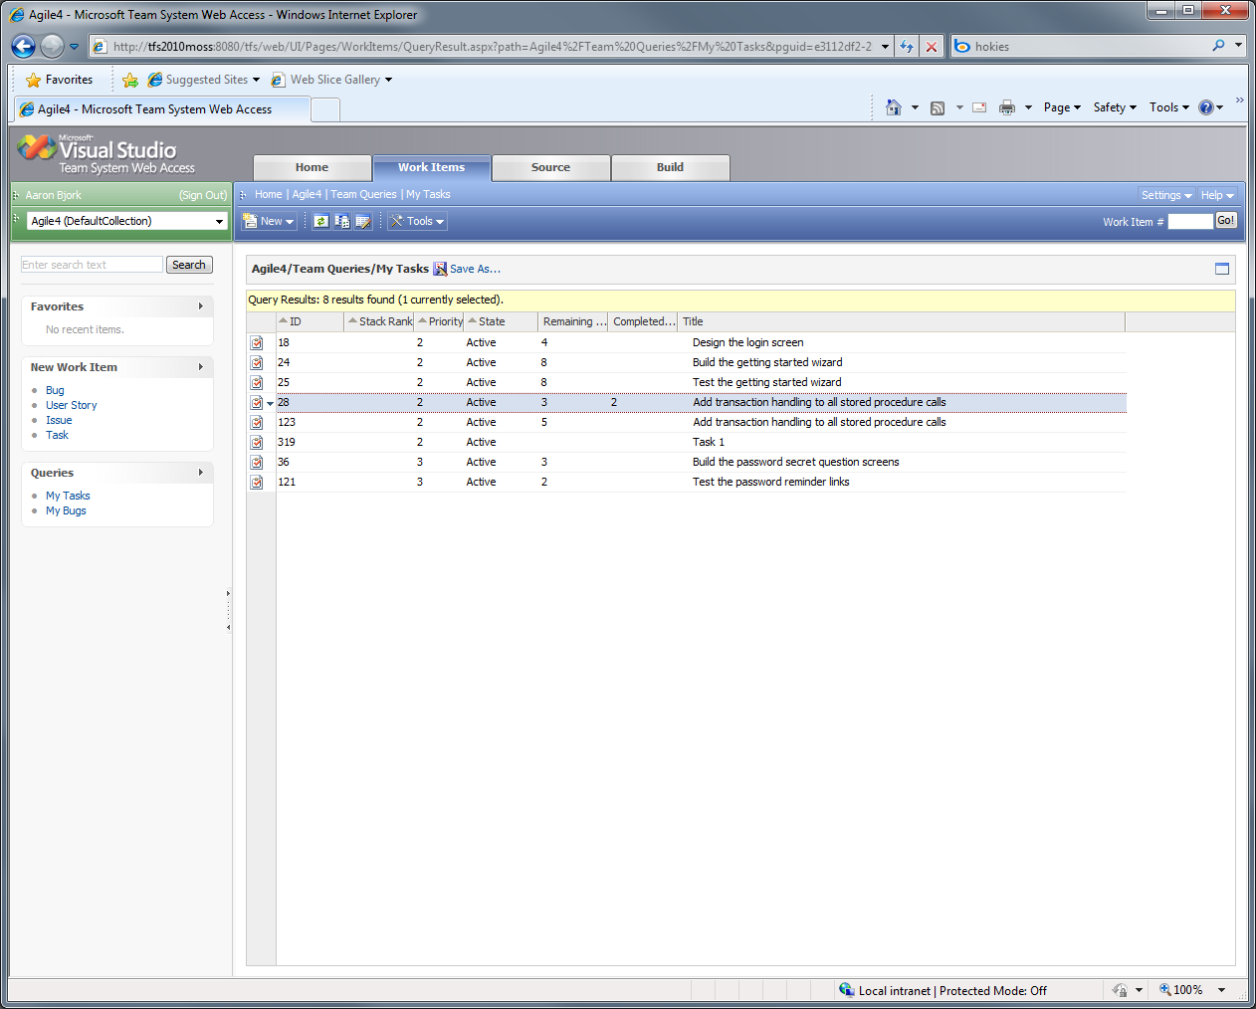
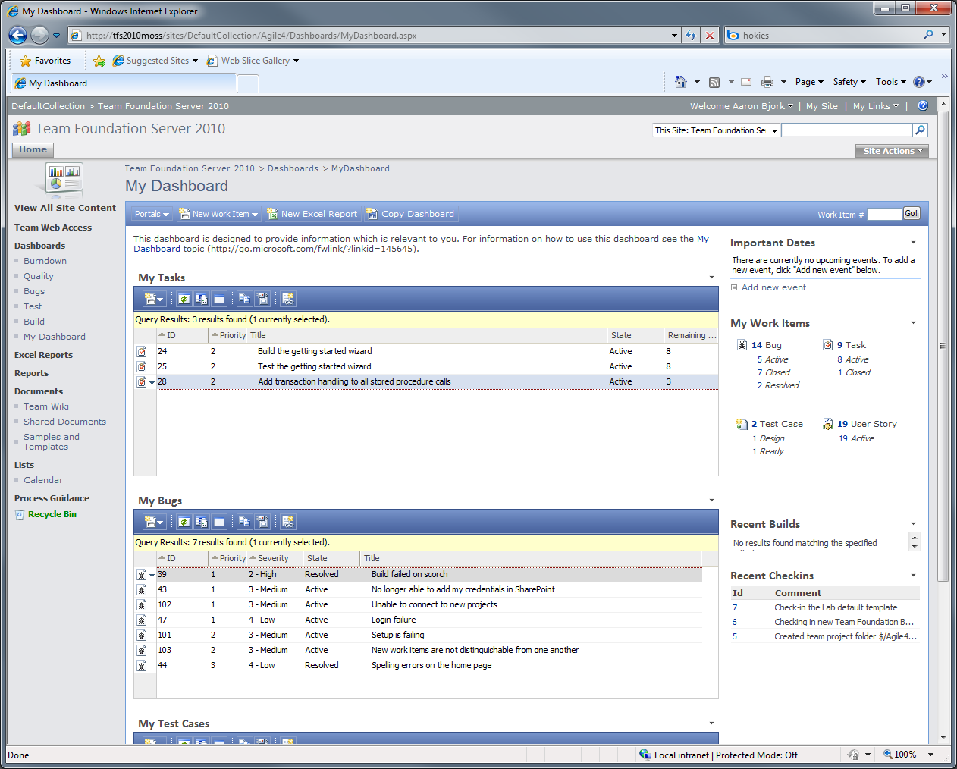
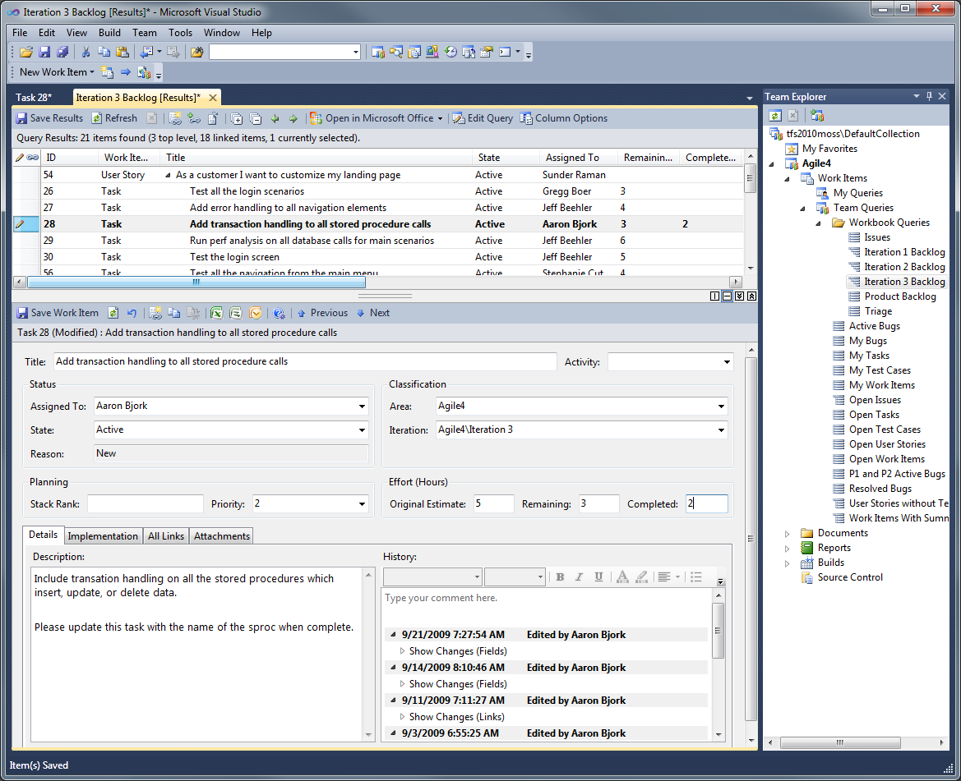
Updating Tasks
Multiple interfaces for updating work items

Slide 54
Updating Tasks
Team Explorer

Slide 55
Updating Tasks
Iteration Backlog workbook

Slide 56
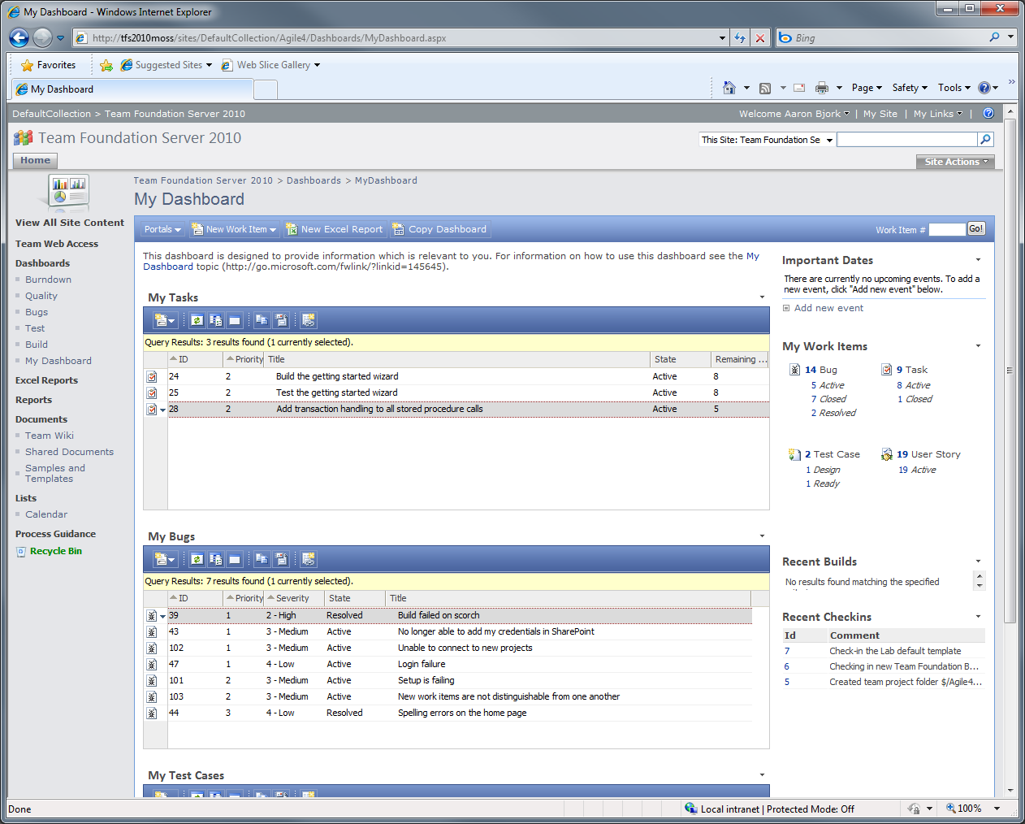
Updating Tasks
Team Project portal

Slide 57
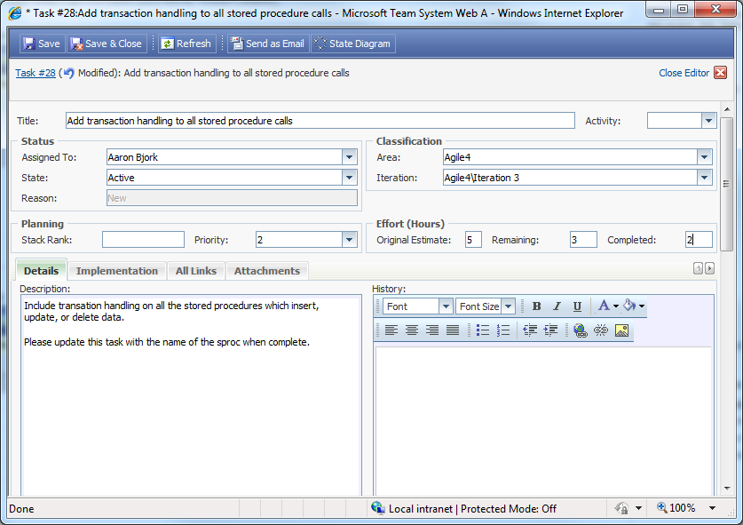
Updating Tasks

Slide 58
Updating Tasks

Slide 59
Updating Tasks
Team Web Access

Slide 60
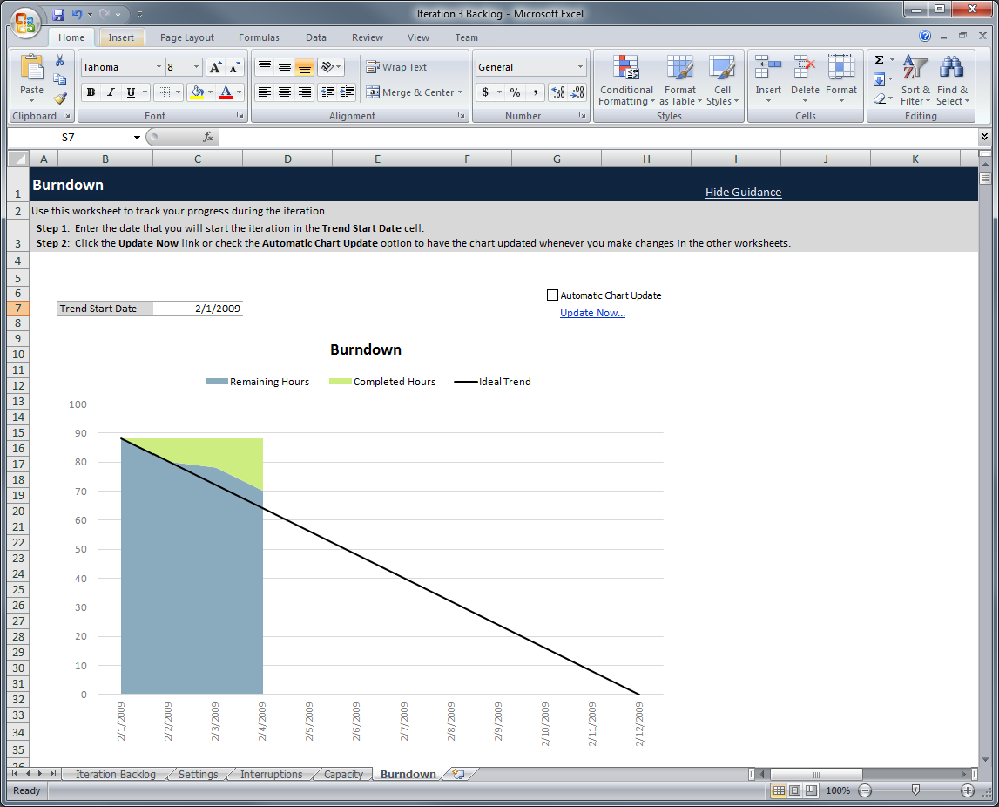
Tracking Progress
Burndown chart tracks remaining and completed work

Slide 61
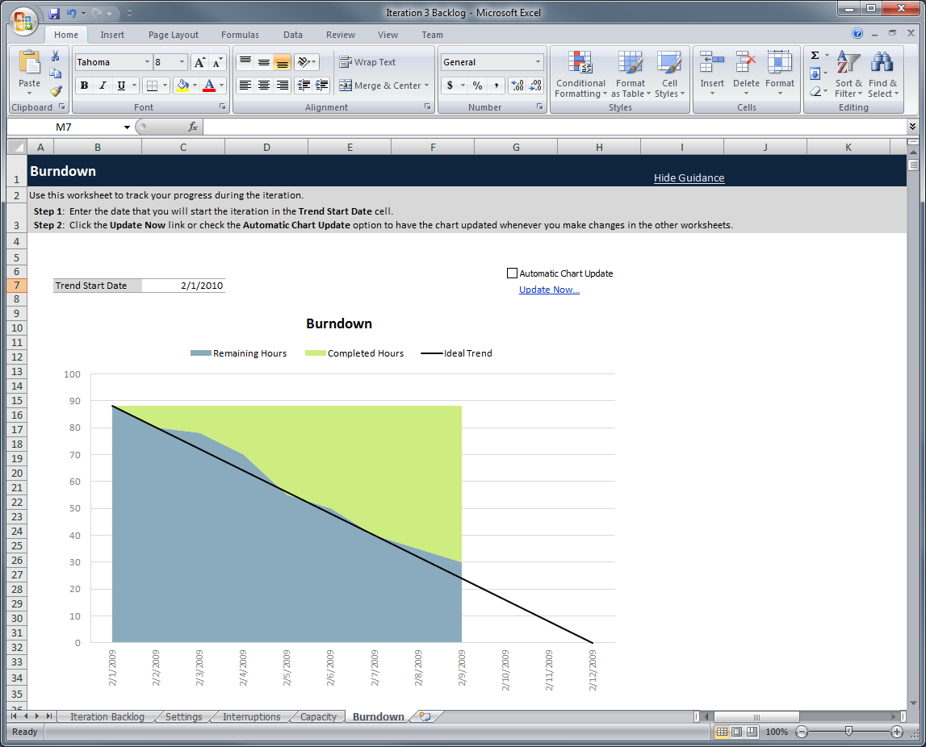
Tracking Progress

Slide 62
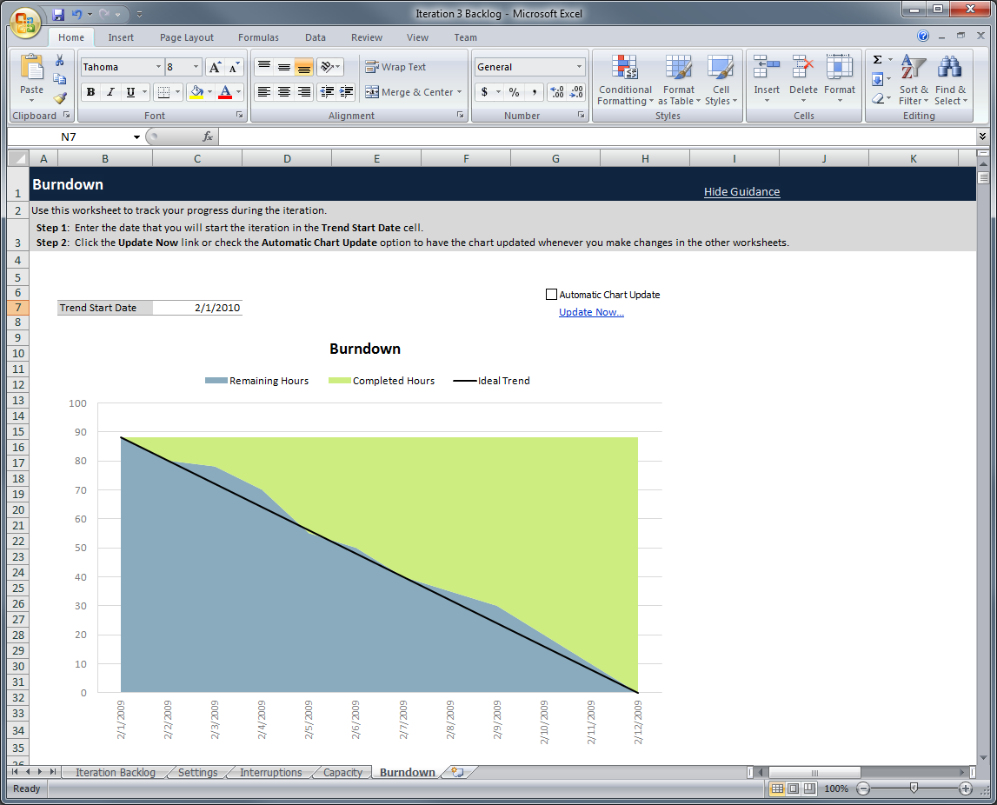
Tracking Progress

Slide 63
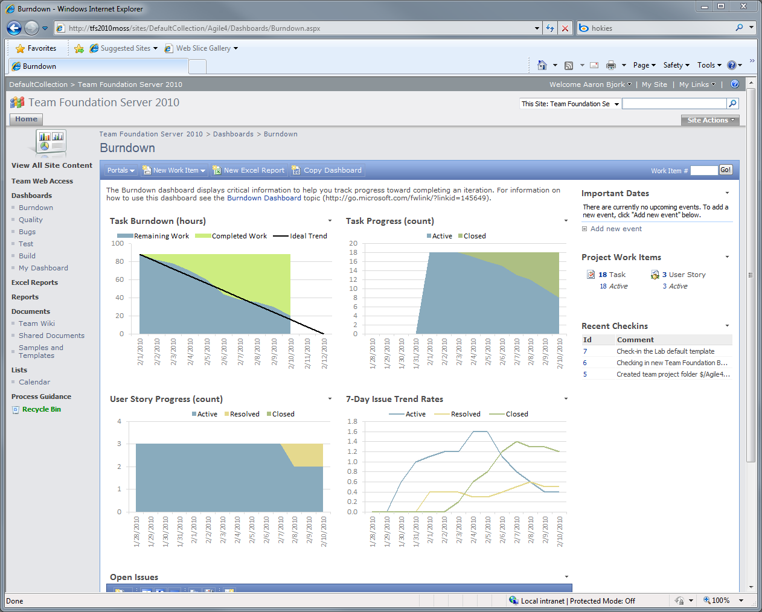
Tracking Progress
Detailed sprint progress is tracked on the project portal
The burndown shows the team on track…
And almost half of the tasks remain open
But the team hasn’t closed any of the three stories…

Slide 64
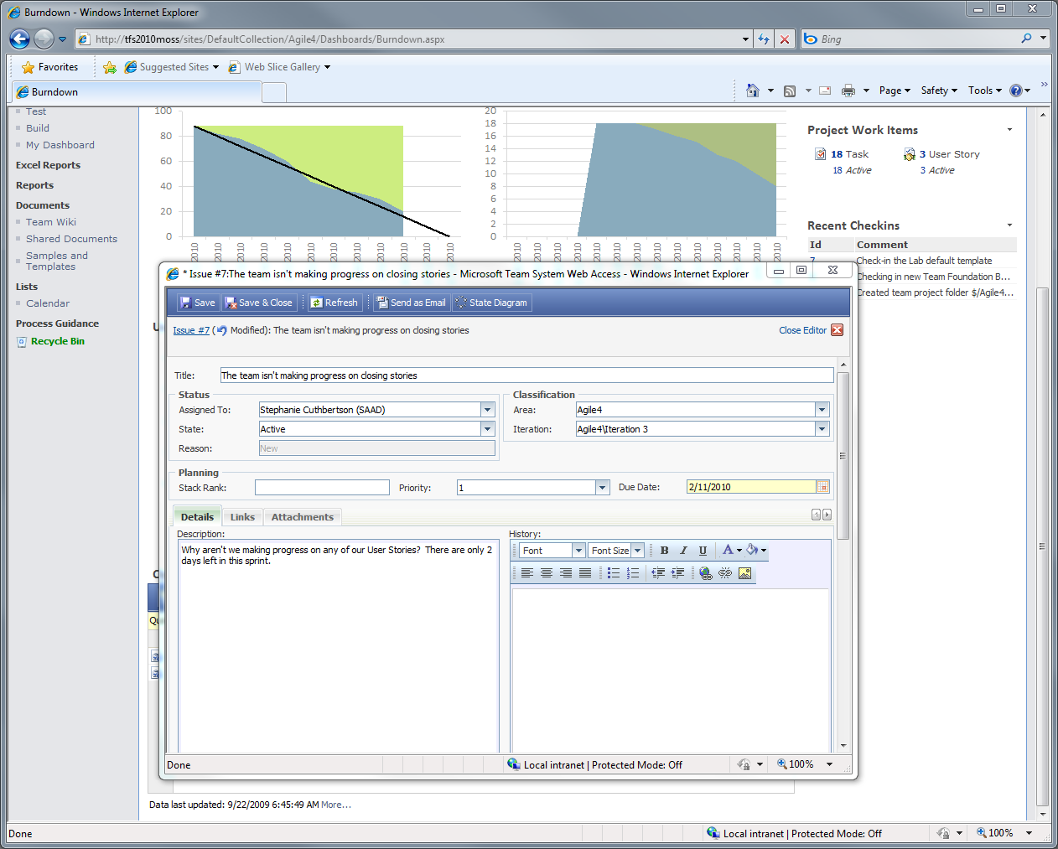
Tracking Progress
The Scrummaster opens an issue to track the problem the portal has identified

Slide 65
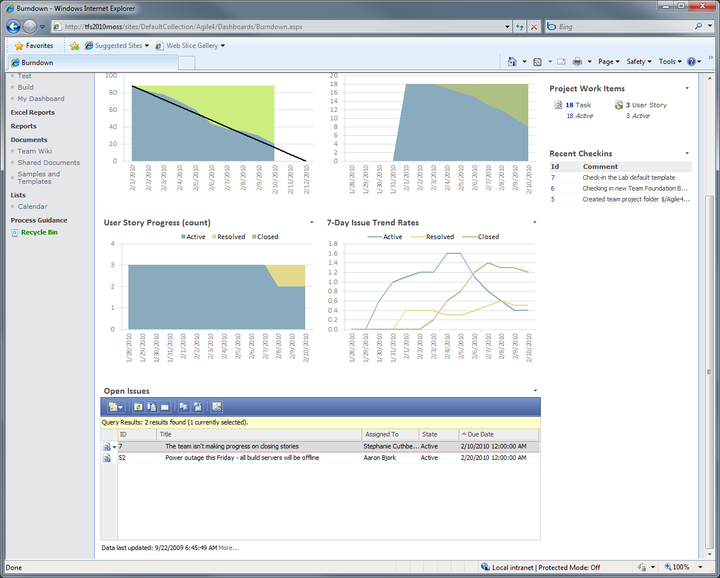
Tracking Progress
The issue is opened and tracked in TFS

Slide 66
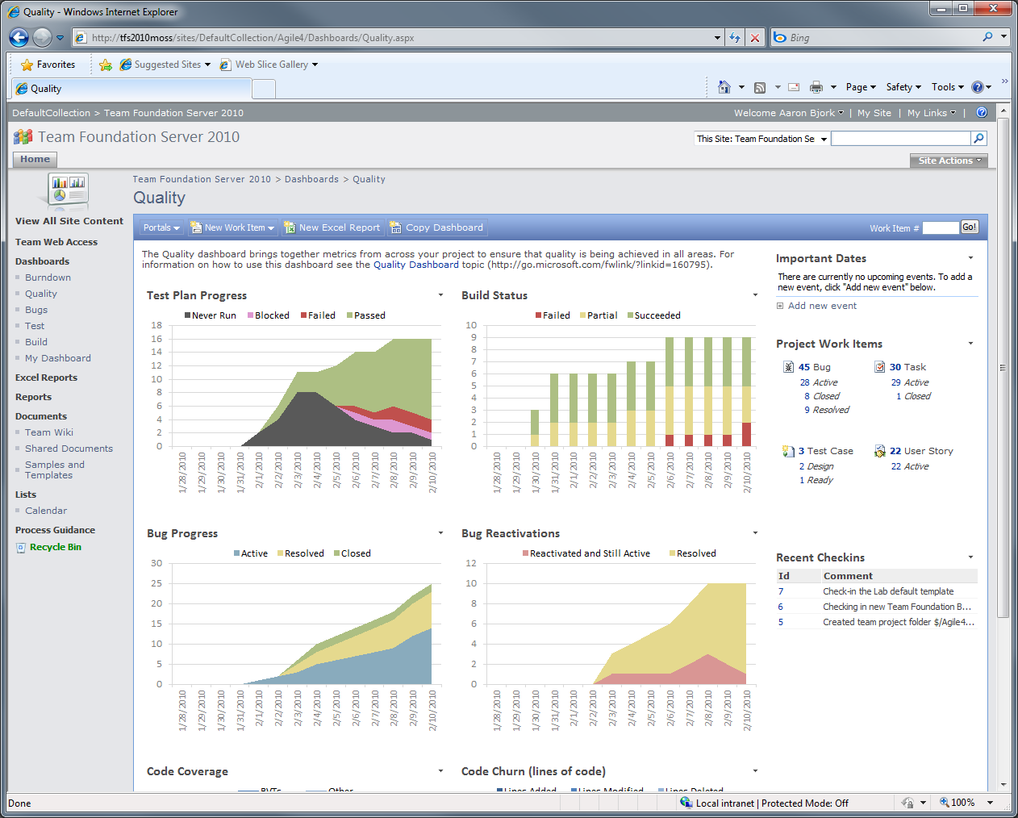
Tracking Progress
The portal brings data together so it can be analyzed to ensure success on a sprint
Test are passing…
But bugs are climbing steadily

Slide 67
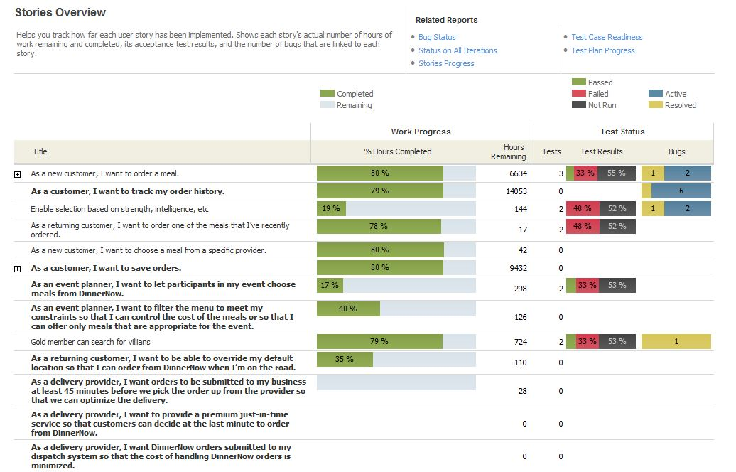
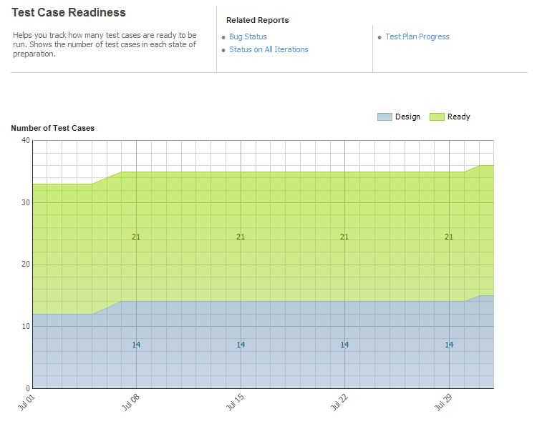
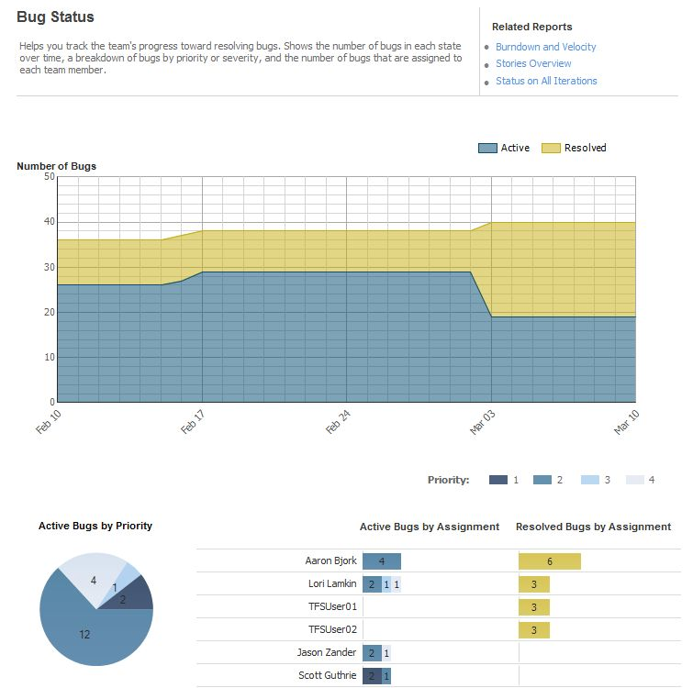
Tracking Progress
Rich set of reports track progress

Slide 68
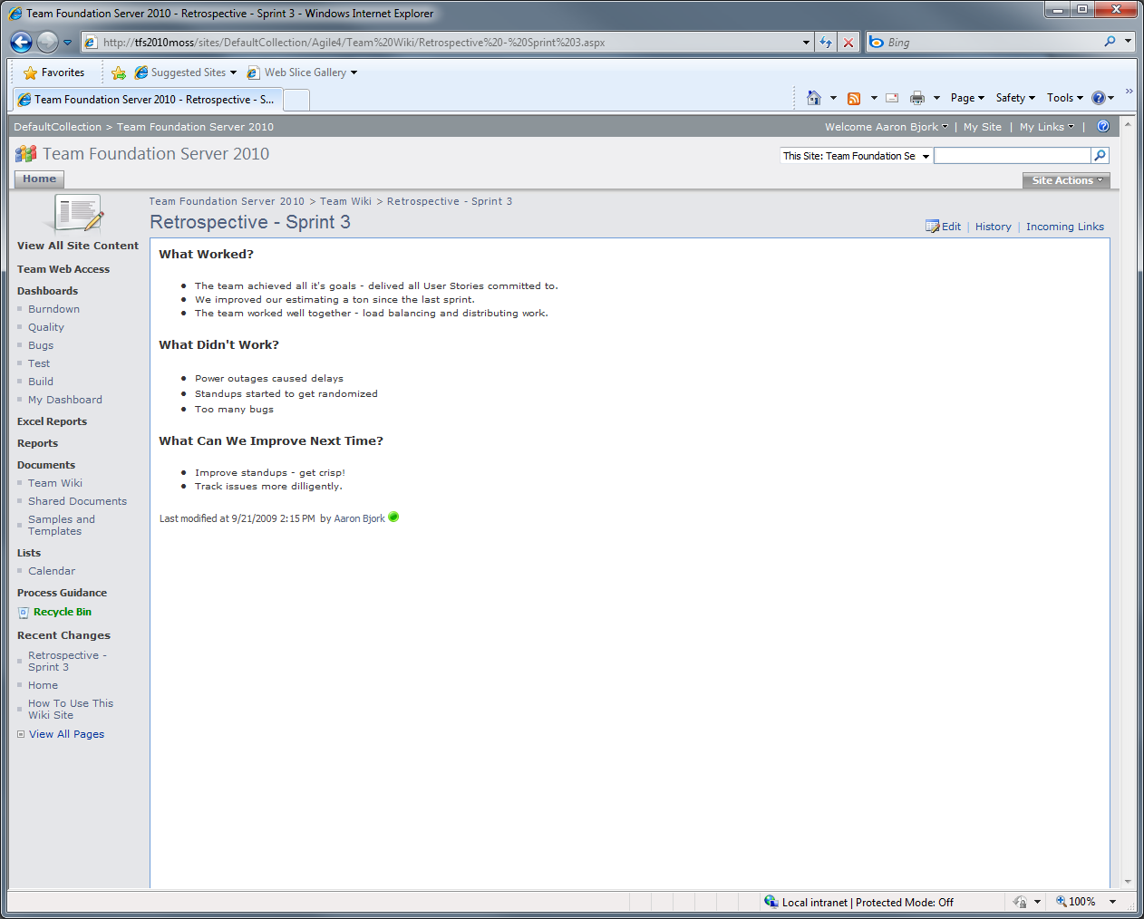
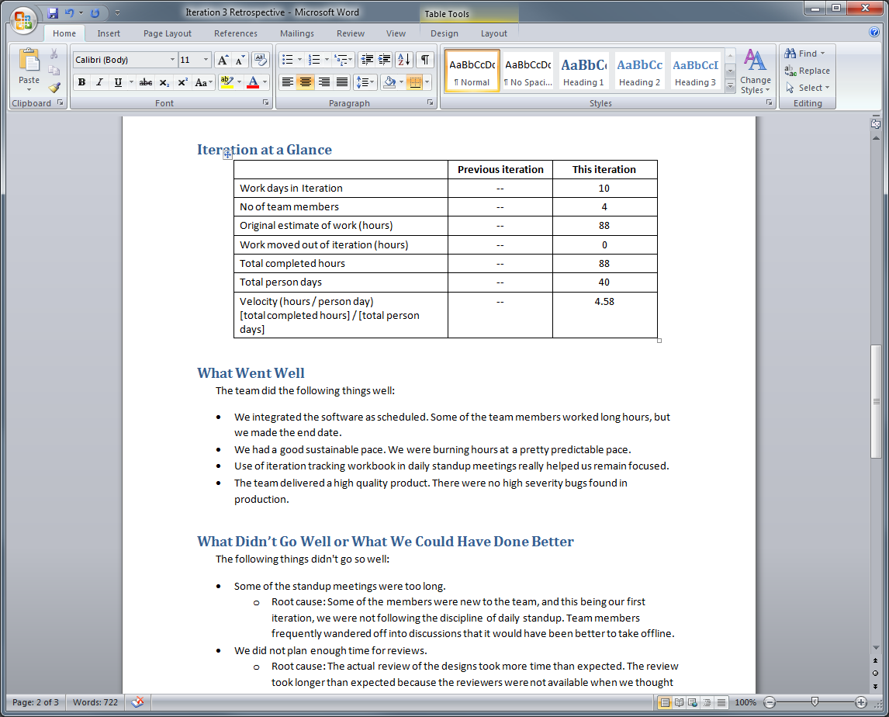
Retrospective
Capture retrospectives using the Team wiki on the Project Portal
Sample documents are provided as a guide

Slide 69
Agenda
Scrum with TFS 2010 using MSF for Agile 5.0
Planning the Project
How do you plan the project?
Project planning in TFS 2010
Planning a Sprint
What is sprint planning?
Sprint planning in TFS 2010
Running a Sprint
How do you run a sprint?
Running a sprint in TFS 2010

Slide 70
Questions/Follow-Up
Contact
Aaron Bjork
abjork@microsoft.com
http://blogs.msdn.com/aaronbjork
TFS Resources
http://blogs.msdn.com/bharry
http://social.msdn.microsoft.com/Forums/en-US/category/vsts
http://msdn.microsoft.com/en-us/teamsystem/default.aspx

Slide 71

© 2009 Microsoft Corporation. All rights reserved. Microsoft, Windows, Windows Vista and other product names are or may be registered trademarks and/or trademarks in the U.S. and/or other countries.
The information herein is for informational purposes only and represents the current view of Microsoft Corporation as of the date of this presentation. Because Microsoft must respond to changing market conditions, it should not be interpreted to be a commitment on the part of Microsoft, and Microsoft cannot guarantee the accuracy of any information provided after the date of this presentation. MICROSOFT MAKES NO WARRANTIES, EXPRESS, IMPLIED OR STATUTORY, AS TO THE INFORMATION IN THIS PRESENTATION.

